Slide 1
Network Security

Slide 2

Definitions
Computer Security - generic name for the collection of tools designed to protect data and to thwart hackers
Network Security - measures to protect data during their transmission
Internet Security - measures to protect data during their transmission over a collection of interconnected networks
Notes:
Here are some key definitions, note boundaries between them are blurred.

Slide 3



What is Security?
Security is the protection of assets.
The three main aspects are:
Prevention
Detection
Re-action

Slide 4



Simplified Scenario
Alice
Network:
    Internet
    intranet
    LAN
    WAN
    …
Eve
How to protect?
  Encrypt
    Key agreement
  Authenticate
Issues:
  Protocols
  Protection (crypto)
Bob

Slide 5
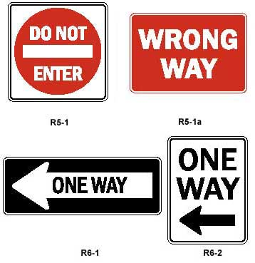


Computer Security
deals with the prevention and detection of unauthorised actions by users of a computer system.

Slide 6
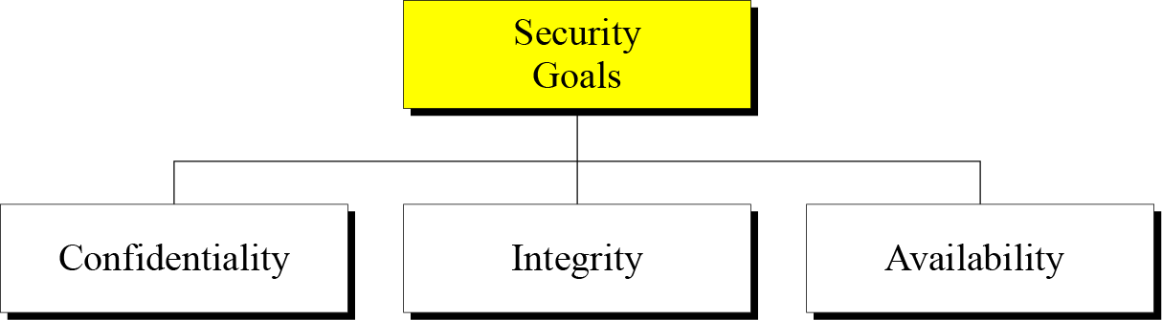
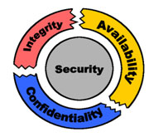
Security Goals

Slide 7

Confidentiality addressee has sole access to electronic document
The prevention of unauthorised disclosure of information.
Confidentiality is keeping information secret or private.
Confidentiality might be important for military, business or personal reasons.
السرية
Notes:
disclosure إفشاء

Slide 8

Integrity digital content cannot be tampered with
Integrity is the prevention of unauthorised writing or modification of information.
Integrity means that there is an external consistency in the system - everything is as it is expected to be.
Data integrity means that the data stored on a computer is the same as the source documents.
السلامة من العبث

Slide 9
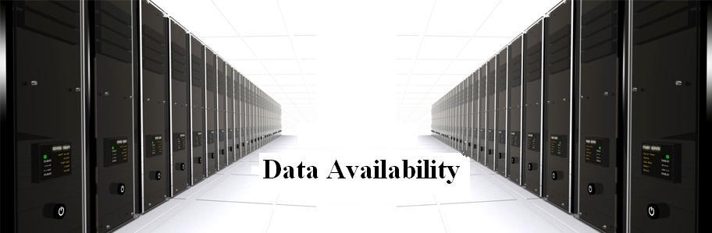
Availability present and ready for use; obtainable
Information should be accessible and useable upon appropriate demand by an authorised user.
Availability is the prevention of unauthorised withholding of information.
Denial of service attacks are a common form of attack.
الاتاحية

Slide 10
What Features Should a Computer Security System Provide?
Authentication
Security
Goals
Access Controls
Non-repudiation
Accountability

Slide 11
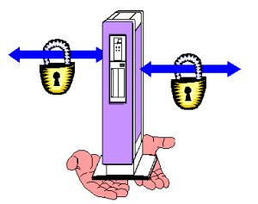
Non-repudiation sender identity cannot be altered
Non-repudiation is the prevention of either the sender or the receiver denying a transmitted message.
A system must be able to prove that certain messages were sent and received.
Non-repudiation is often implemented by using digital signatures.
عدم التنصل

Slide 12

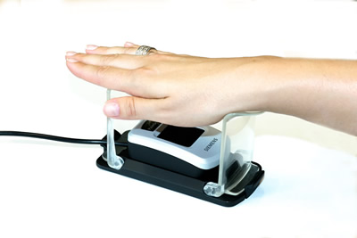
Authentication end-user identity guaranteed
Proving that you are who you say you are, where you say you are, at the time you say it is.
Authentication may be obtained by the provision of a password or a scan of your retina.
التوثيق (المصادقة)

Slide 13
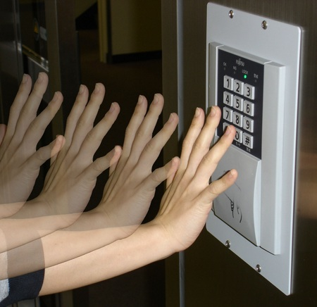
Access Controls
The limitation and control of access through identification and authentication.
A system needs to be able to identify and authenticate users for access to data, applications and hardware.
In a large system there may be a complex structure determining which users and applications have access to which objects.

Slide 14

Accountability
The system managers are accountable to scan from outside.
Audit trails must be selectively kept and protected so that actions affecting security can be traced back to the responsible party
المساءلة
Notes:
Audit trails must be selectively kept and protected مراجعة الحسابات

Slide 15
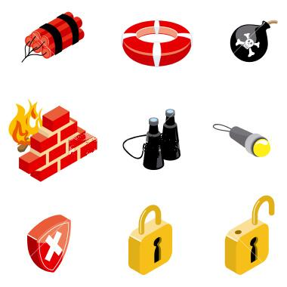
Security systems
A security system is not just a computer package. It also requires security personnel who respect the procedures and their role in the system.
Conversely, a good security system should not rely on personnel having security expertise.

Slide 16
Risk Analysis
The disadvantages of a security system are that they are time-consuming, costly, and impede management and smooth running of the organization.
Risk analysis is the study of the cost of a particular system against the benefits of the system.
Notes:
إعاقة الإدارة والتشغيل السلس للمنظمة

Slide 17
Designing a Security System
There are a number of design considerations:
Does the system focus on the data, operations or the users of the system?
What level should the security system operate from? Should it be at the level of hardware, operating system or applications package?
Should it be simple or sophisticated?
In a distributed system, should the security be centralised or spread?

Slide 18



Friends and enemies: Alice, Bob, Trudy
well-known in network security world
Bob, Alice (lovers!) want to communicate “securely”
Trudy (intruder) may intercept, delete, add messages
Alice
Bob
channel
data, control messages
secure
sender
secure
receiver
data
data
Trudy

Slide 19

Who might Bob, Alice be?
… well, real-life Bobs and Alices!
Web browser/server for electronic transactions (e.g., on-line purchases)
on-line banking client/server
DNS servers
routers exchanging routing table updates
other examples?

Slide 20

OSI Security Architecture
ITU-T X.800 “Security Architecture for OSI”
defines a systematic way of defining and providing security requirements
for us it provides a useful, if abstract, overview of concepts we will study
Notes:
To assess effectively the security needs of an organization and to evaluate and choose various security products and policies, the manager responsible for security needs some systematic way of defining the requirements for security and characterizing the approaches to satisfying those requirements. This is difficult enough in a centralized data processing environment; with the use of local and wide area networks,the problems are compounded. ITU-T Recommendation X.800, Security Architecture for OSI, defines such a systematic approach. The OSI security architecture is useful to managers as a way of organizing the task of providing security.

Slide 21
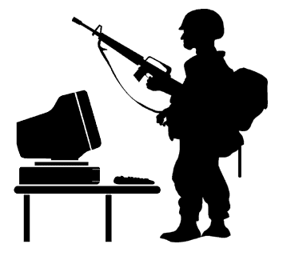
Aspects of Security
consider 3 aspects of information security:
  security attack
  security mechanism
  security service
Notes:
The OSI security architecture focuses on security attacks,mechanisms,and services. These can be defined briefly as follows:
• Security attack: Any action that compromises the security of information owned by an organization.
• Security mechanism: A process (or a device incorporating such a process) that is designed to detect, prevent,or recover from a security attack.
• Security service: A processing or communication service that enhances the security of the data processing systems and the information transfers of an organization.The services are intended to counter security attacks, and they make use of one or more security mechanisms to provide the service.

Slide 22

Security Attack
information security is about how to prevent attacks, or failing that, to detect attacks on information-based systems
often threat & attack used to mean same thing
have a wide range of attacks
can focus of generic types of attacks
  passive
  active
Notes:
Expand on definition and use of “security attack”, as detailed above.
See Stallings Table 1.1 for definitions of threat and attack.

Slide 23









Adversary types
Bob
Alice
Alice and Bob want to communicate in presence of attackes
  attackes:
    Passive – just looking
    Active – may change msgs
Notes:
Adversaries

Slide 24

Passive Attacks
Notes:
Have “passive attacks” which attempt to learn or make use of information from the system but does not affect system resources.
By eavesdropping on, or monitoring of, transmissions to:
+ obtain message contents (as shown above in Stallings Figure 1.3a), or
+ monitor traffic flows
Are difficult to detect because they do not involve any alteration of the data.

Slide 25
Active Attacks
Modification or creation of messages (by attackers)
Four categories: modification of messages, replay, denial of service
Easy to detect but difficult to prevent
Defense: detect attacks and recover from damages

Slide 26
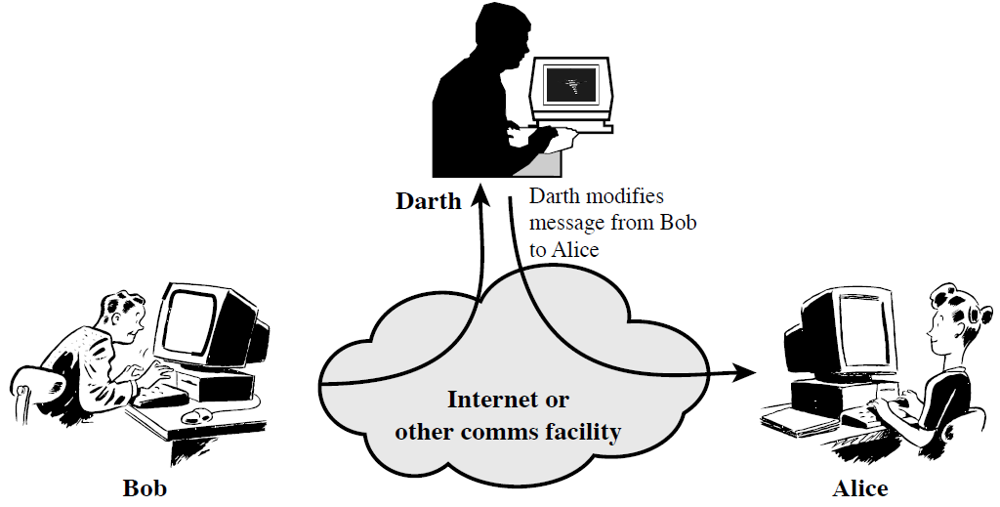
Active Attacks; Modification
Notes:
Also have “active attacks” which attempt to alter system resources or affect their operation.
By modification of data stream to:
+ masquerade of one entity as some other
+ replay previous messages (as shown above in Stallings Figure 1.4b)
+ modify messages in transit
+ denial of service
Active attacks present the opposite characteristics of passive attacks. Whereas passive attacks are difficult to detect, measures are available to prevent their success. On the other hand, it is quite difficult to prevent active attacks absolutely, because of the wide variety of potential physical,software,and network vulnerabilities. Instead, the goal is to detect active attacks and to recover from any disruption or delays caused by them.

Slide 27
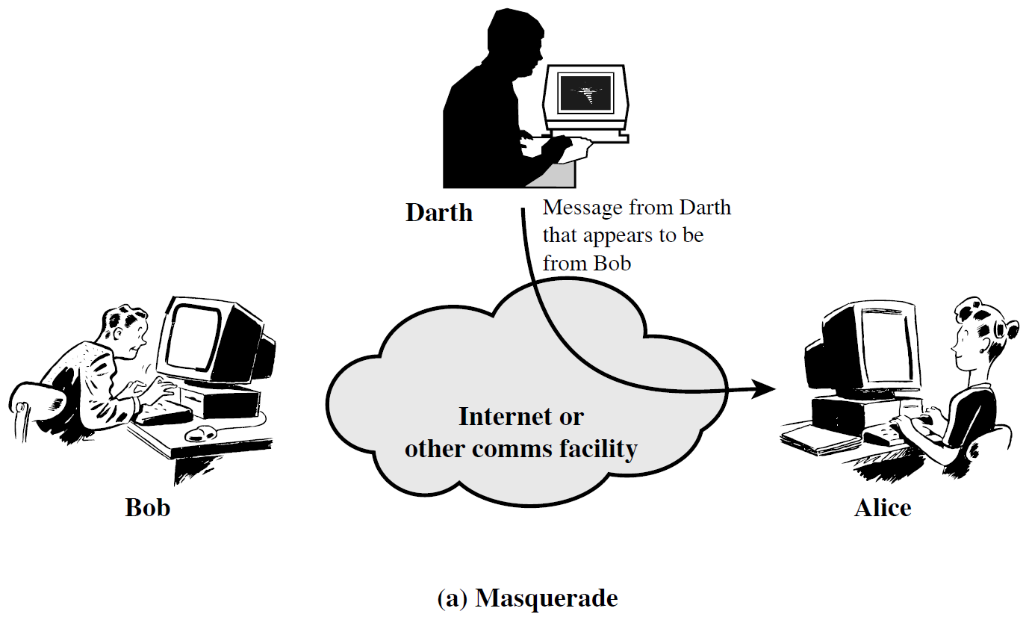
Active Attacks; Masquerade
التنكر

Slide 28

Active Attacks; Replay

Slide 29
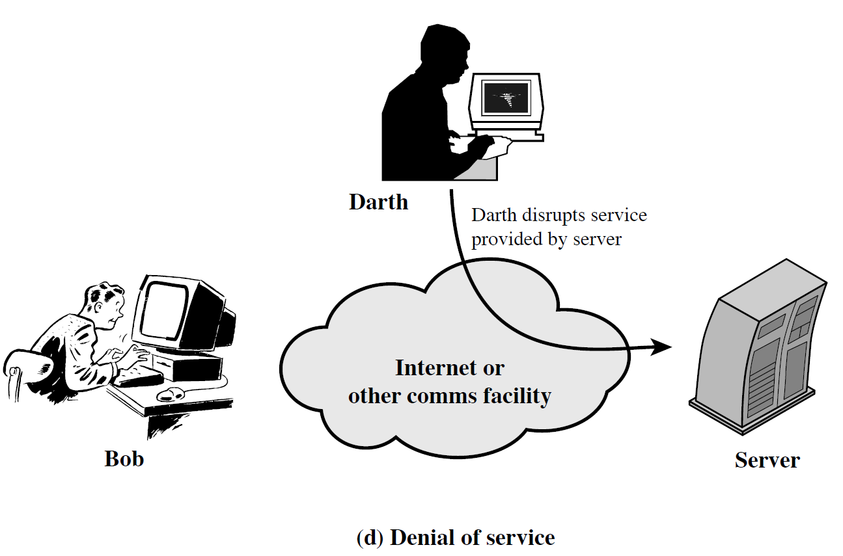
Active Attacks; Denial of service

Slide 30
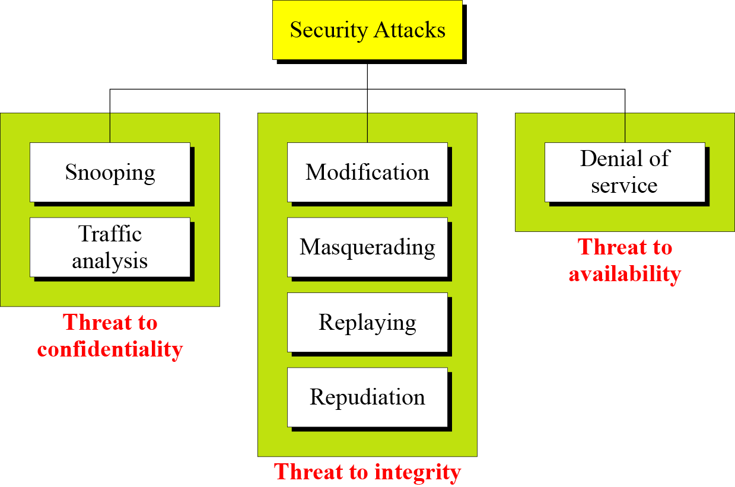
Taxonomy of Attacks with Relation to Security Goals
Notes:
Snooping تجسس

Slide 31
Attacks Threatening Confidentiality
Snooping refers to unauthorized access to or interception of data.
Traffic analysis refers to obtaining some other type of information by monitoring online traffic.
1.<number>
Notes:
1.#

Slide 32
Attacks Threatening Integrity
Modification means that the attacker intercepts the message and changes it.
Masquerading or spoofing happens when the attacker impersonates somebody else.
Replaying means the attacker obtains a copy
of a message sent by a user and later tries to replay it.
Repudiation means that sender of the message might later deny that she has sent the message; the receiver of the message might later deny that he has received the message.
1.<number>
Notes:
1.#

Slide 33
Attacks Threatening Availability
Denial of service (DoS) is a very common attack. It may slow down or totally interrupt the service of a system.
1.<number>
Notes:
1.#

Slide 34
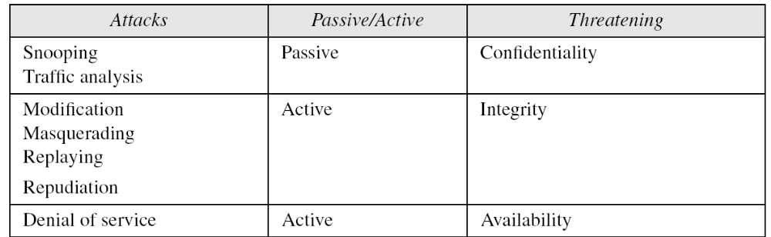
Passive Versus Active Attacks
1.<number>
Notes:
1.#

